Slide 1
Integration Test Plan
My taxi Service Project

Slide 2
Purpose, scope and definitions
To describe the system’s required inte- gration testing framework and infrastructure
Targeted to the project testers
Component: High level element of the architectural design phase. Com-ponents make up the structure of the system;
Module: Low level element of the architectural design phase. Modules join together to build a single component;

Slide 3
Integration strategy
Entry criteria:
  code has been inspected
  unit tests have been run
Test the integration of the modules that make a single component (Big Bang approach)
Integration of the components (Top-Down approach)

Slide 4
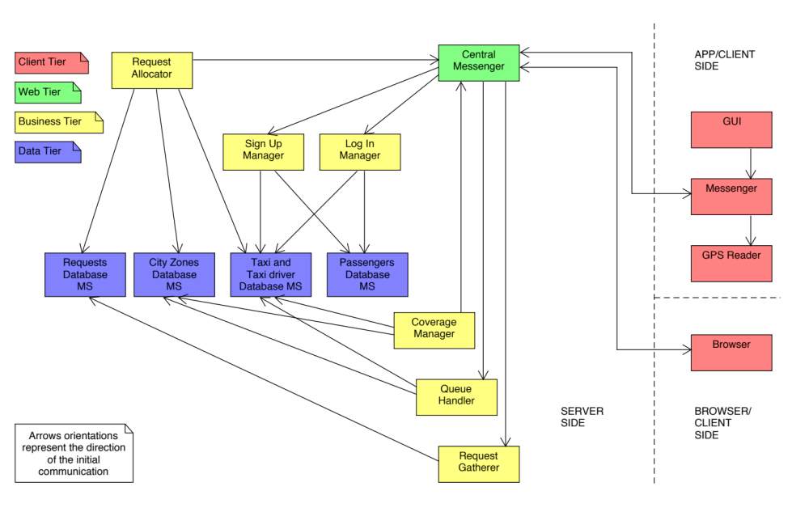
Architecture

Slide 5
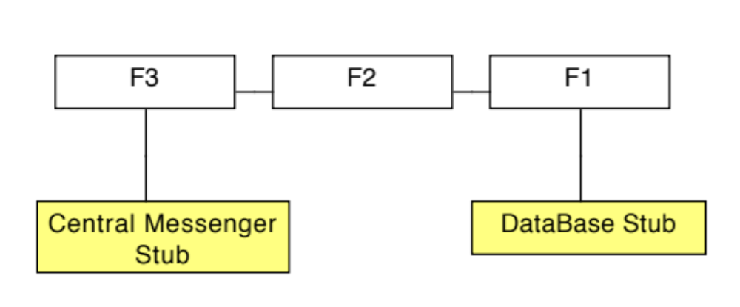
Ex. Coverage Manager
F1 = A Data module that interfaces with databases making DBMS queries;
F2 = An Analysis module that analyses information received from Data module and calculates the best coverage;
F3 = A Communication module that interfaces with Central Messenger in order to send messages to Taxi Drivers selected by Analysis module.

Slide 6
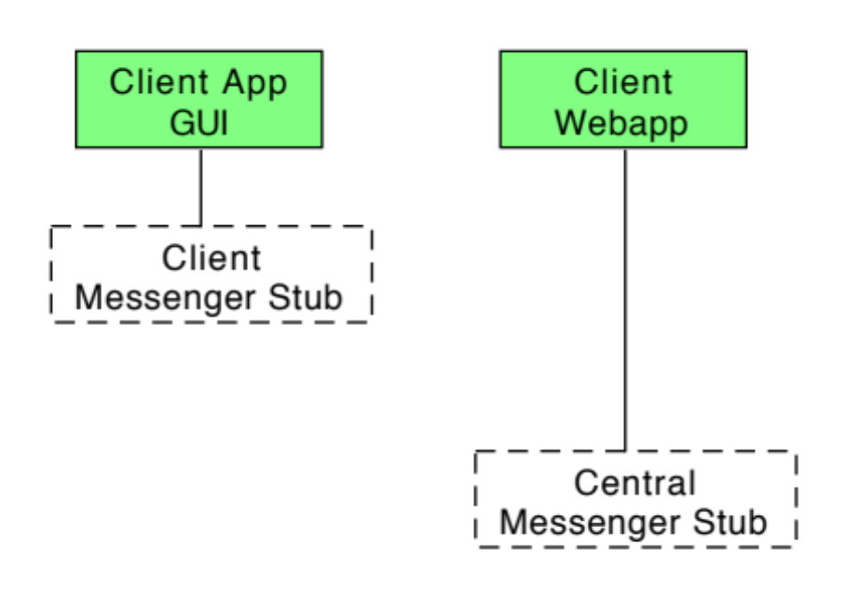
Component integration plan

Slide 7
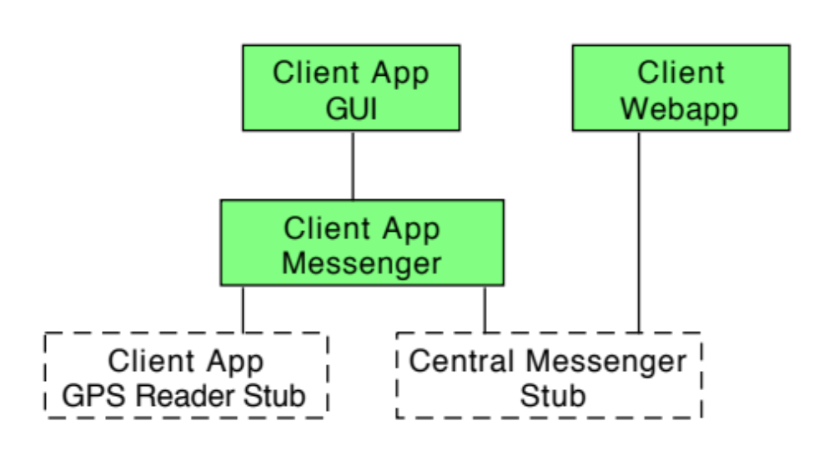
Component integration plan

Slide 8
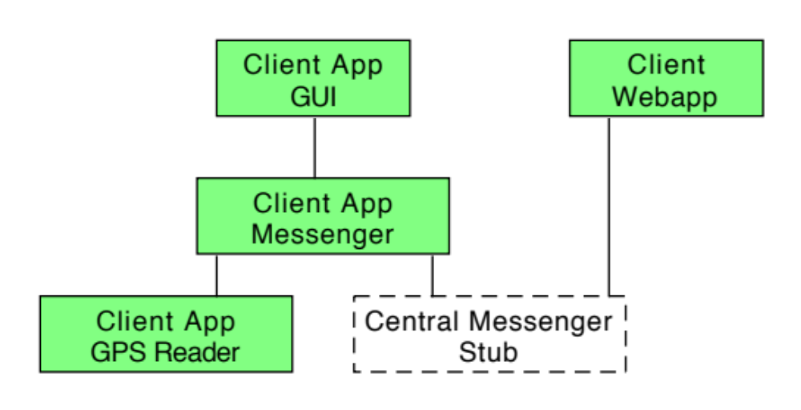
Component integration plan

Slide 9
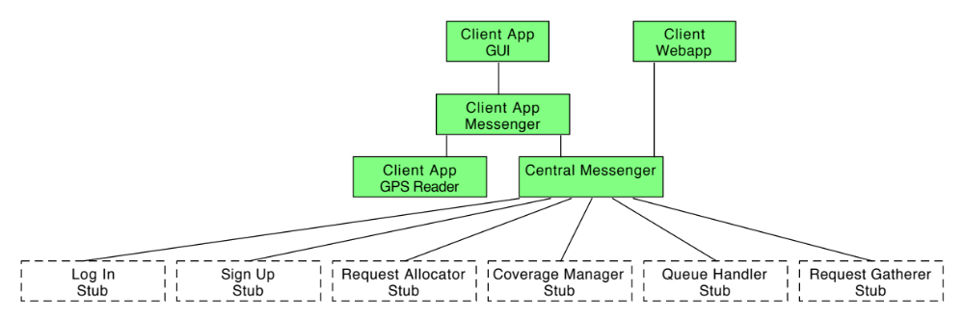
Component integration plan

Slide 10
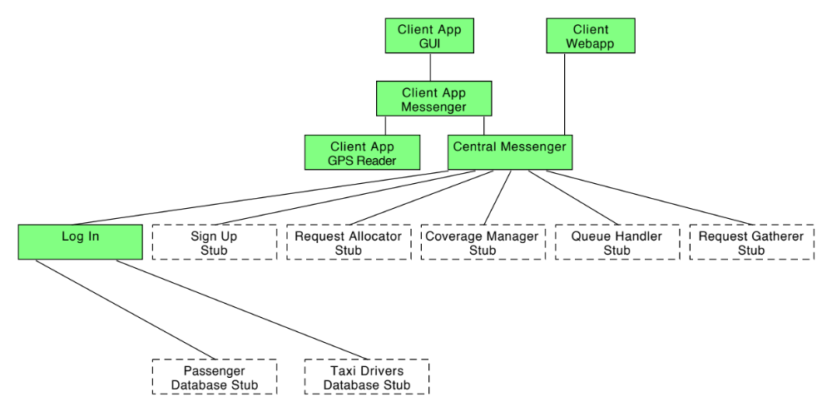
Component integration plan

Slide 11
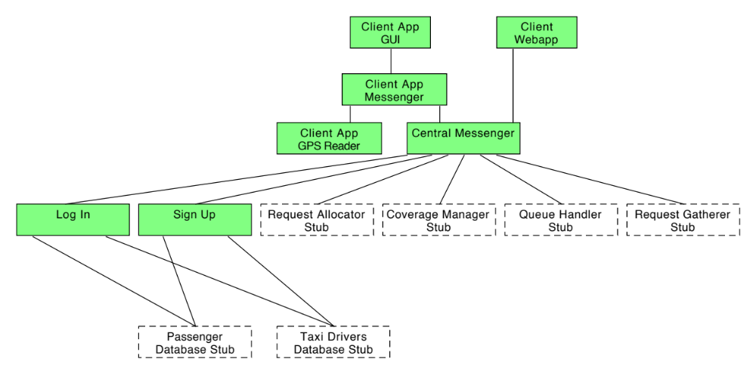
Component integration plan

Slide 12
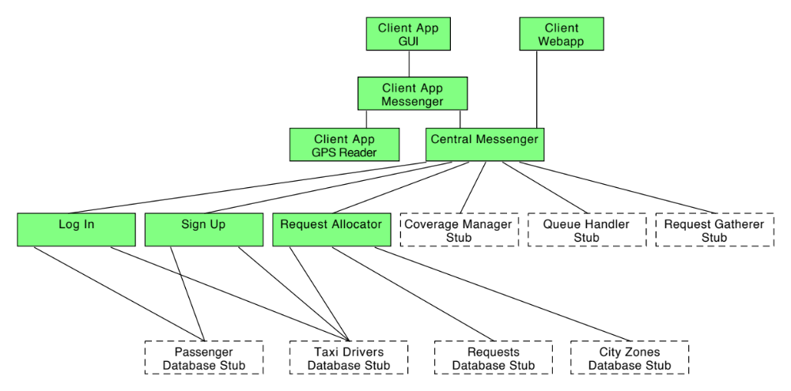
Component integration plan

Slide 13
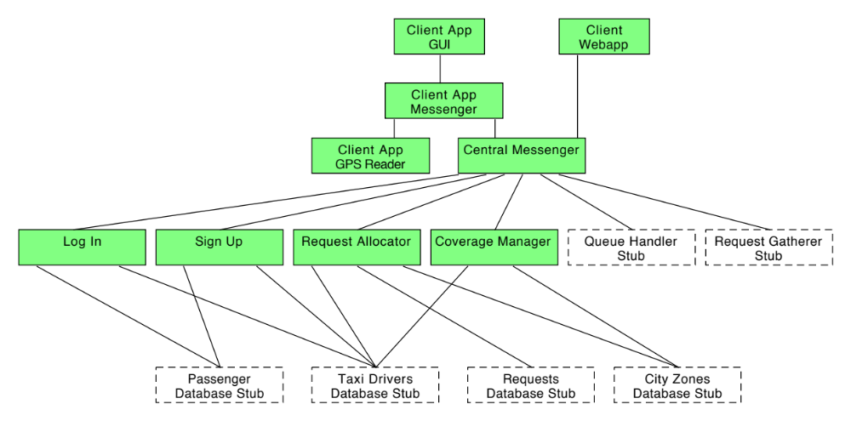
Component integration plan

Slide 14
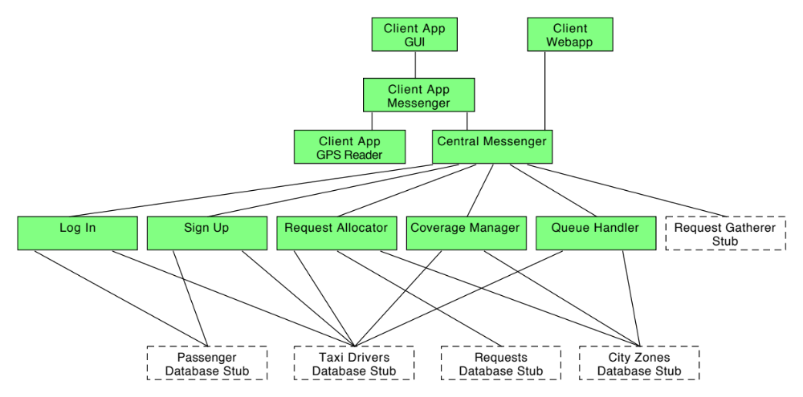
Component integration plan

Slide 15
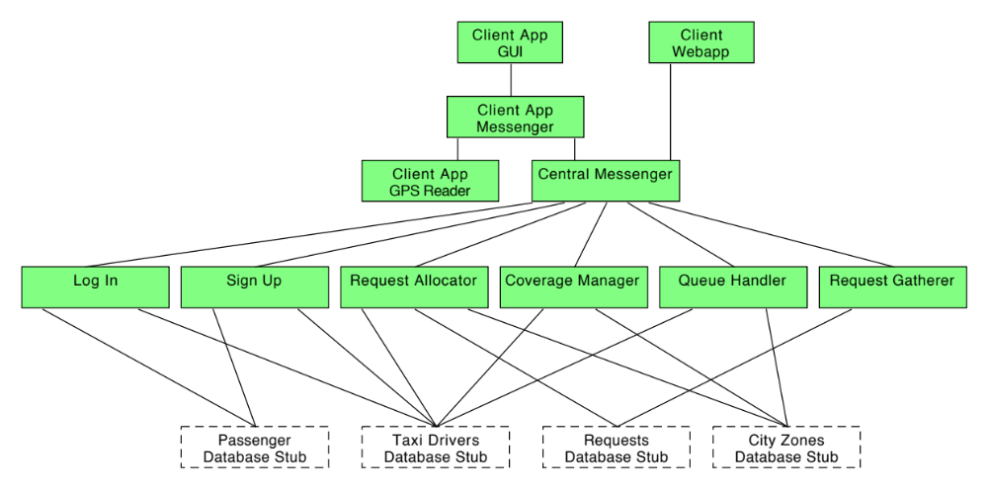
Component integration plan

Slide 16
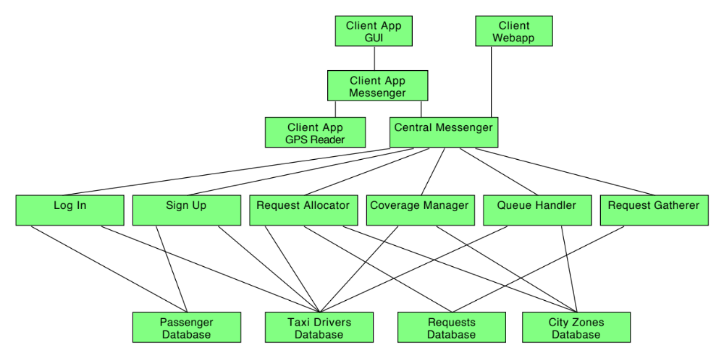
Component integration plan

Slide 17
Individual Test Description
Identifier | Component Integration 2
Purpose | Test whether the App Central Messenger properly receives user input from the GUI; Test whether the App Central Messenger properly generates reactive output data to be displayed by the GUI.
Test Items | App GUI → App Central Messenger
Input Specification | Typical user input data
Output Specification | Check if the data is correct and is relayed and displayed properly
Environmental needs | Integration tests up to CI1 have been executed A stub for the App GPS Reader A stub for the Server Central Messenger

Slide 18
Individual Test Description
Identifier | Component Integration 8
Purpose | Test whether the Coverage Manager properly sends data; Test whether the Coverage Manager properly receives an- swers from Central Messenger;
Test Items | Server Central Messenger → Coverage Manager
Input Specification | None
Output Specification | Check if a message of Coverage Fulfillment is received in Client App GUI
Environmental needs | Integration tests up to CI4 have been executed A stub for the Passenger Database A stub for the Taxi Drivers Database A stub for the Requests Database A stub for the City Zones Database A stub for the Queue Handler A stub for the Request Gatherer

Slide 19
Tools and test equipment required
Arquillian
Junit + Mockito
Manual Testing (GUI)
Performance Testing: JMeter (not now)

Slide 20
Program stubs and testing data required
A stub for the App Central Messenger
A stub for the App GPS Reader
A stub for the Server Central Messenger
A stub for the Log In Manager
A stub for the Sign Up Manager
A stub for the Request Allocator
A stub for the Coverage Manager
A stub for the Queue Handler
A stub for the Request Gatherer
A stub for the Passengers Database
A stub for the Taxi Drivers Database
A stub for the Requests Database
A stub for the City Zones Database

